Slide 1
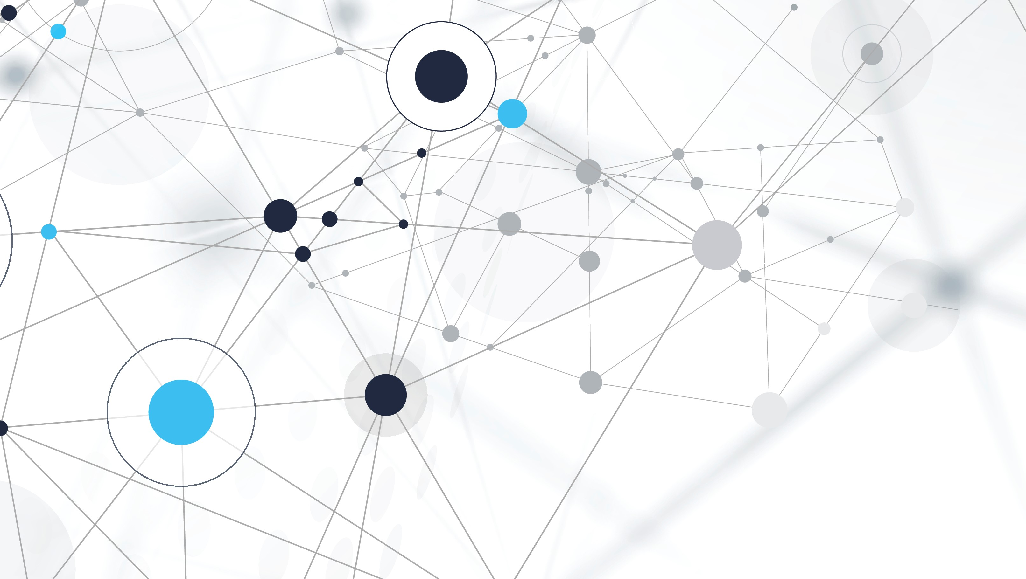
Deep learning-based diagnosis of diseases using image classification
Group 235
Shiva Singh Tomar
Faculty Guide –

Slide 2
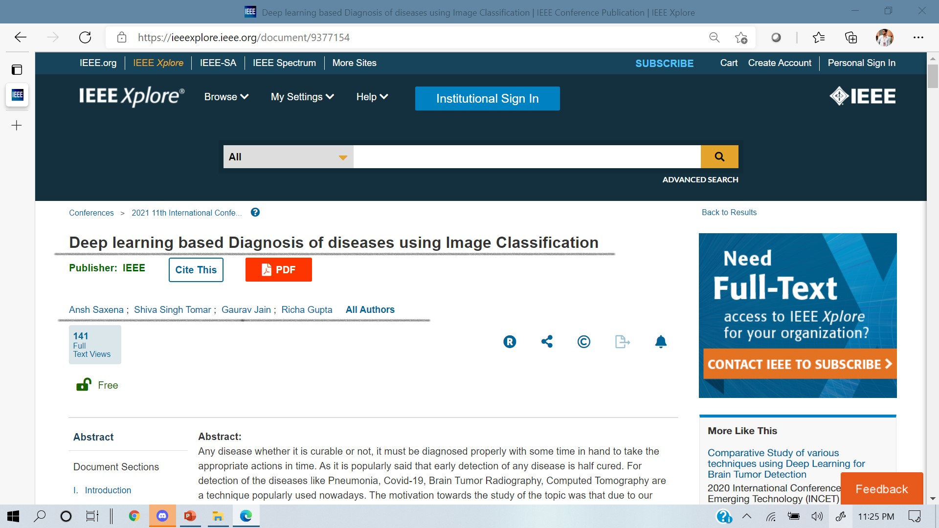
Accomplishments

Slide 3
Project in Brief
Developing organ-wise models to detect various types of diseases based on Image Classification.
Image of the scan given as an input to the classifier model. It detects the image for the presence of a respective diseases.
Aiding the healthcare industry towards early and more accurate diagnosis.
Developing a web interface for detection.
Could give the appropriate course of action and medication in future making it a more wholesome product out of it.

Slide 4
Diseases included in the scope
Novel Corona Virus ( Through Chest X-Rays and CT Scan )
Assist the clinicians to identify patients with COVID-19 Using CNNs to Classify images
Categorizing Images of Covid Dataset using CNNs and divided into positive and negative cases.
Pneumonia ( Through Chest X-Rays )
Assist the clinicians and physicians to identify patients with pneumonia Using CNNs to Classify images
Brain Tumor ( Through MRI Scan )
Assist the clinicians and physicians to identify patients with Brain tumor Using CNNs to Classify images

Slide 5
Motivation
Population of Density of India - 464 People per Km sq. (Source – Indian Consensus)
Vulnerability of Medical Situation of India was exposed during the Covid crisis.
Ratio of Doctors in India – 1:1456
Crucial time wasted – collection of reports, appointment, diagnosis, expert advices and deciding the future implications.

Slide 6
How could Ai help us In solving the problem?
With the help of machine learning we can save the time and can predict patient is infected or not in just 1 minute of time.
Automation required to speed up detection and figuring the procedure to be followed.

Slide 7
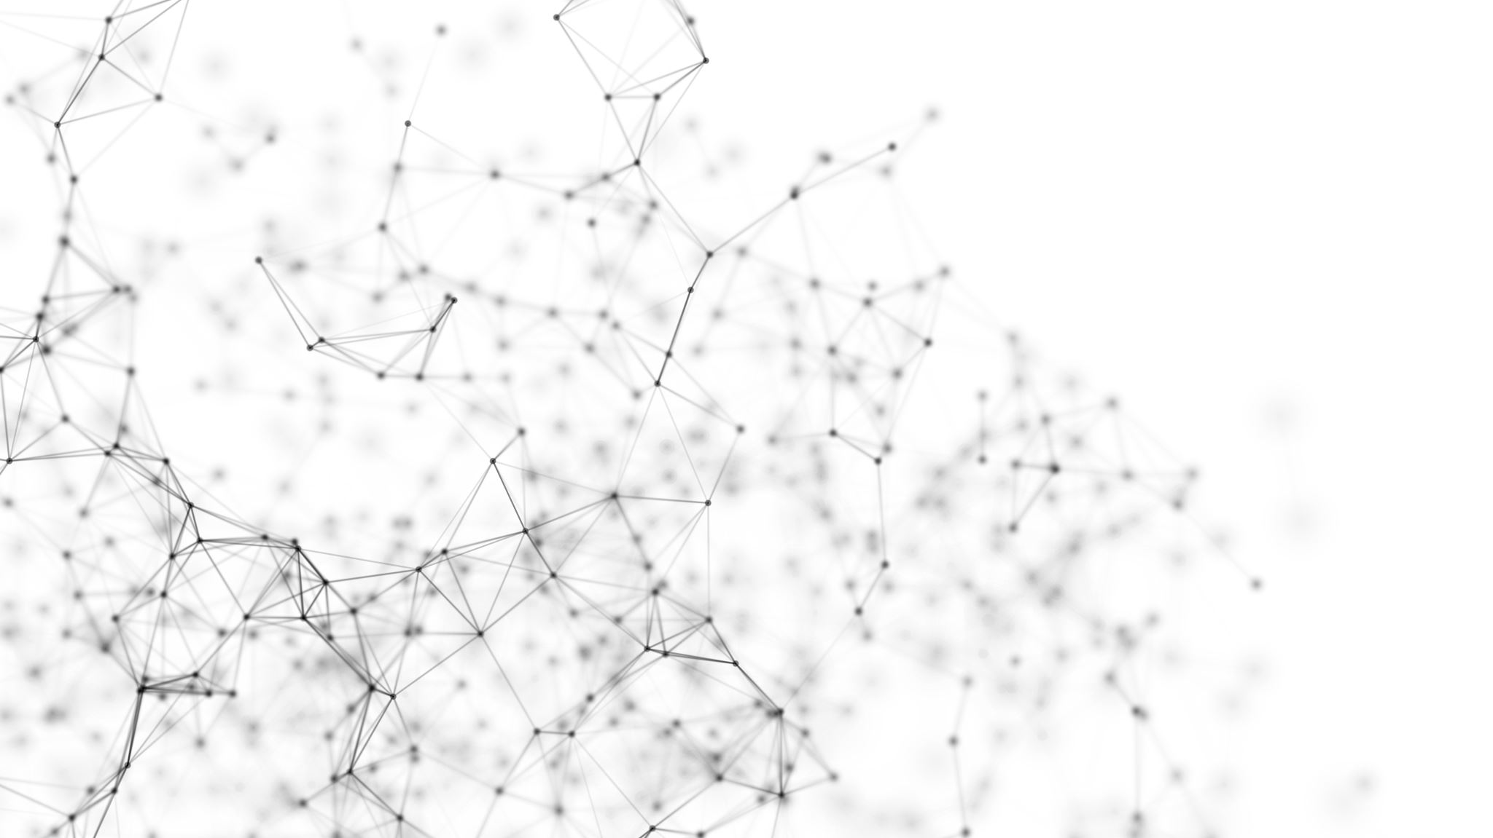
Contribution 1/3 - Deep learning model

Slide 8
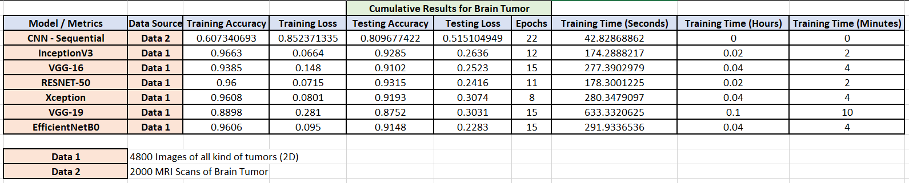
Training process 1
Trained a lot of Transfer Learning Models on the available dataset for Brain Tumor and the results are shown collectively here.
Individual Contribution by Shiva Singh Tomar.

Slide 9
Analysis of Different models

Slide 10
Contribution 2/3 Covid classifier

Slide 11
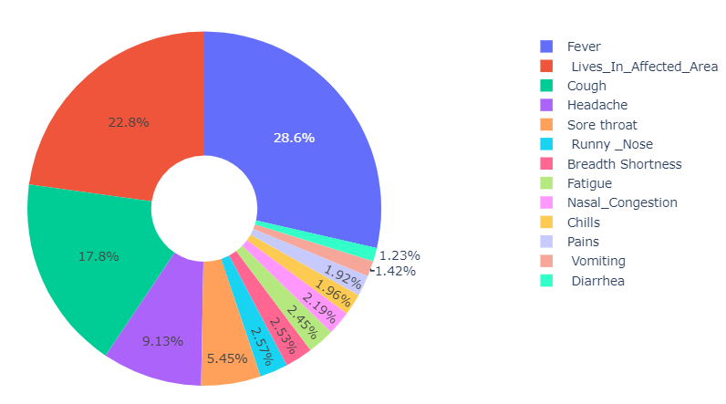
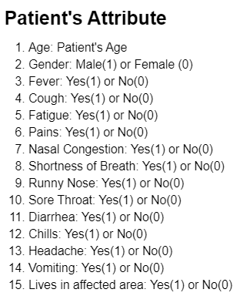
Covid Classifier (Exploratory Data analysis)

Slide 12
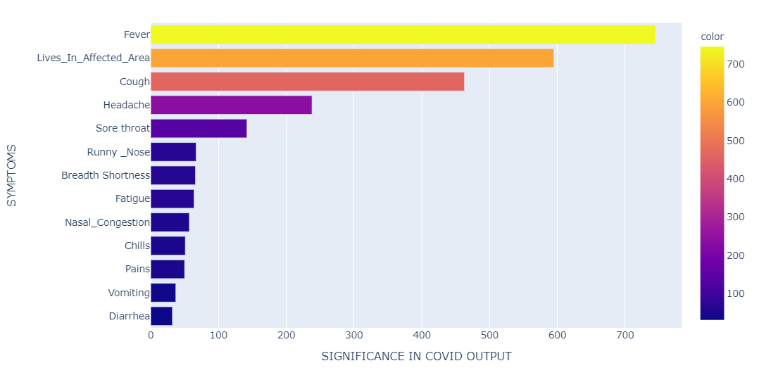
Covid Classifier (Exploratory Data analysis)

Slide 13
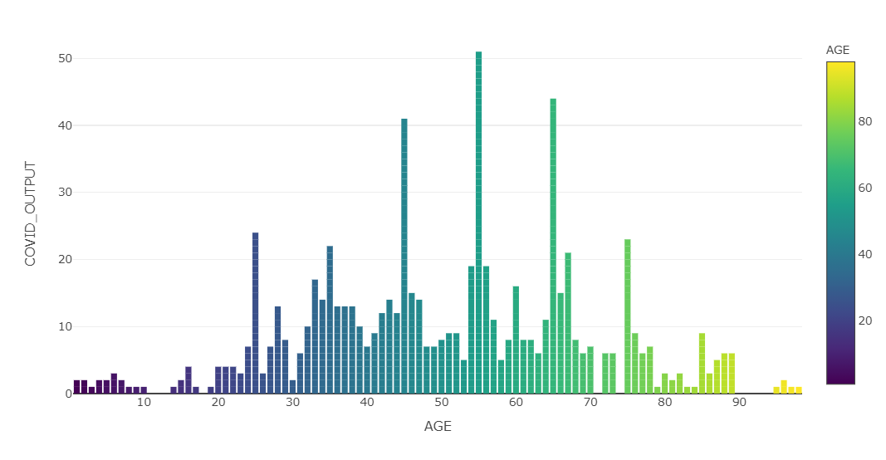
Age vs infection rates

Slide 14
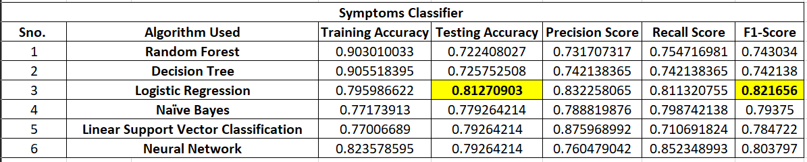
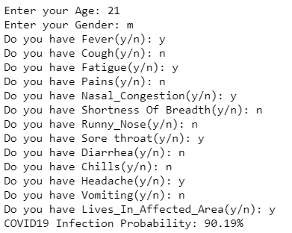
Symptoms Classifier comparison

Slide 15
Contribution 3/3 FLASK FRAMEWORK DEVELOPMENT

Slide 16
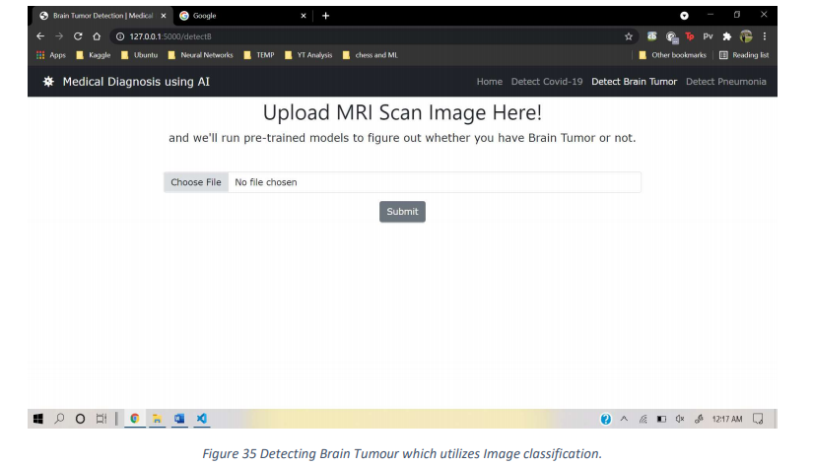
Flask framework and Interface

Slide 17
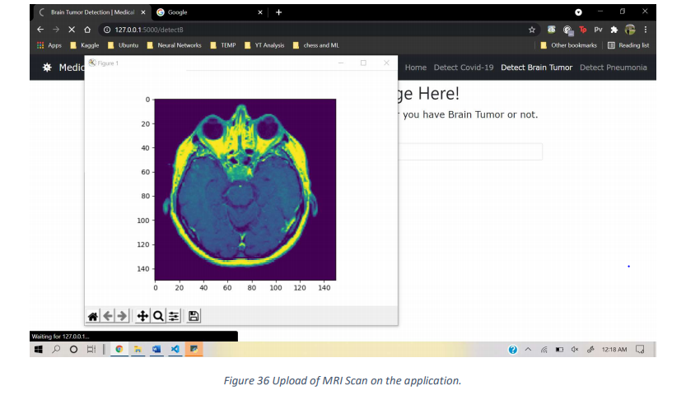
Flask framework and Interface

Slide 18
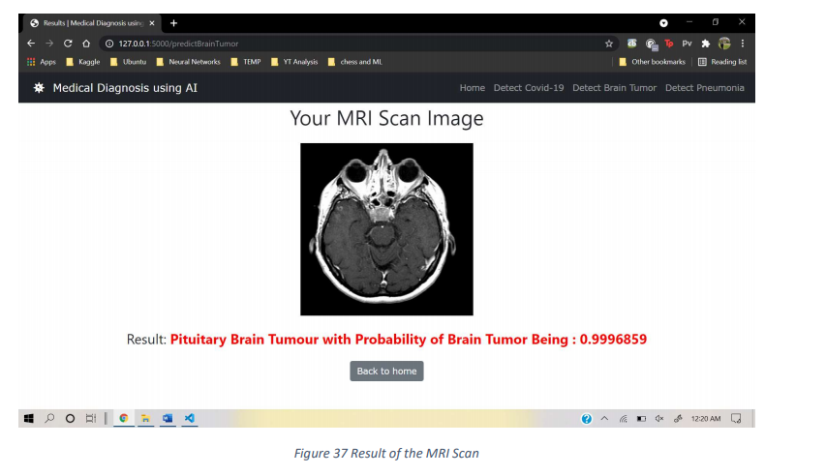
Flask framework and Interface

Slide 19
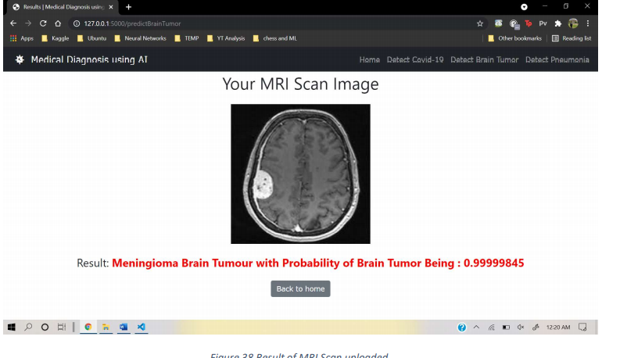
Flask framework and Interface

Slide 20
Future works
The application could connect the patient with the doctor and get the nearest available bed which speeds up the medication process and prevents critical time from being wasted.
It would save lives too by providing all the necessary information to the patient.
In future it could support detection of many more diseases like : Skin Cancer, Lung Cancer, Glaucoma etc.

Slide 21
Thank you!

